Slide 1

MySQL- Health Insurance Claim Database System
Presented by:
Ms. Shruti Jakkulwar

Slide 2
Problem Statement
Develop a relational database system using MySQL to efficiently manage health insurance claims data. This system must support the storage, retrieval, and manipulation of information related to patients, insurance plans, claims, policyholders, and insurance companies. The database should facilitate accurate tracking of claim status, calculation of claim amounts, and generation of reports to aid in the administration of health insurance processes.

Slide 3
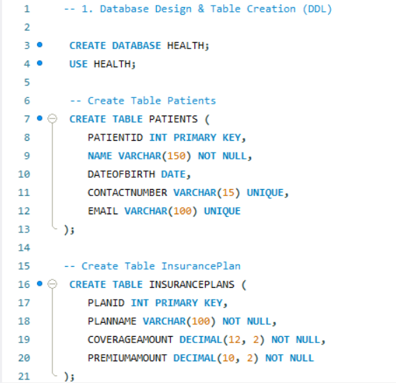
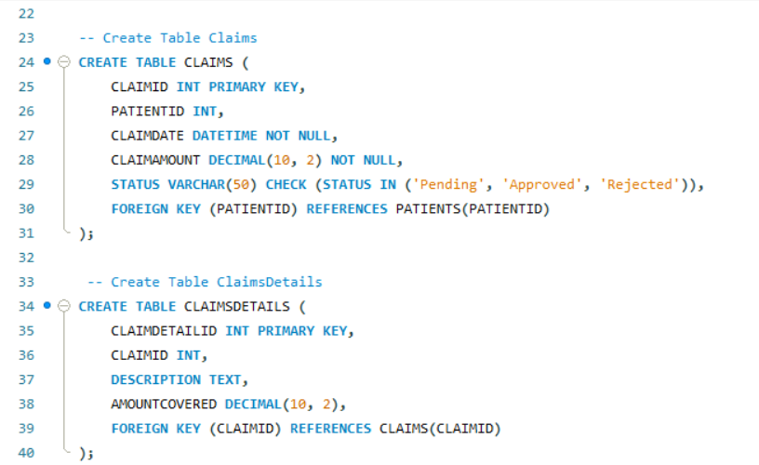
Entity Identification
Observations: Patients stores unique individual records with contact details.
Insurance Plans defines coverage and premium details for different plans
Observations: Claims tracks patient claims with status and links to Patients. Claims Details provides itemized information for each claim.

Slide 4
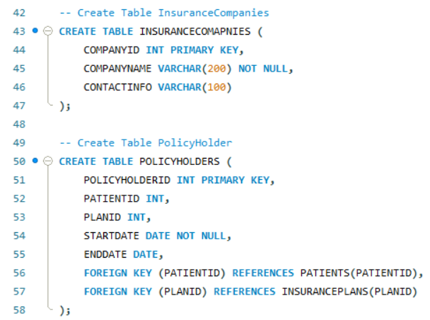
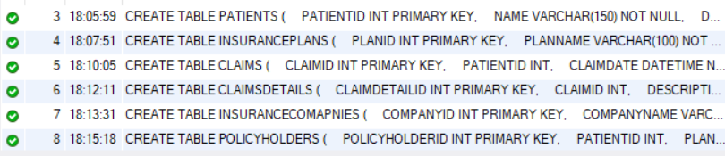
Entity Identification
Observations : Insurance Companies stores names and contact information for insurance providers.
Policy Holders links patients to their insurance plans with start and end dates.

Slide 5
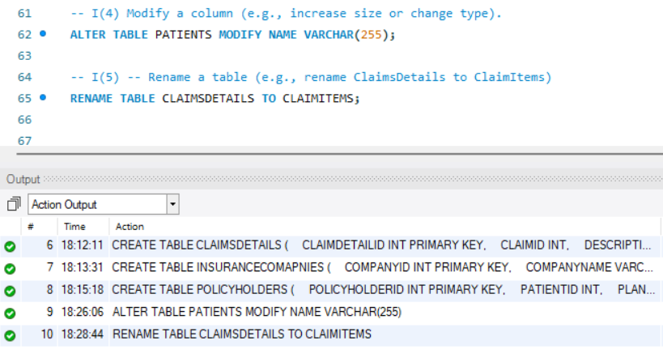
Entity Identification
Observations : The PATIENTS table's NAME column size was altered, and the CLAIMSDETAILS table was renamed to CLAIMITEMS.

Slide 6
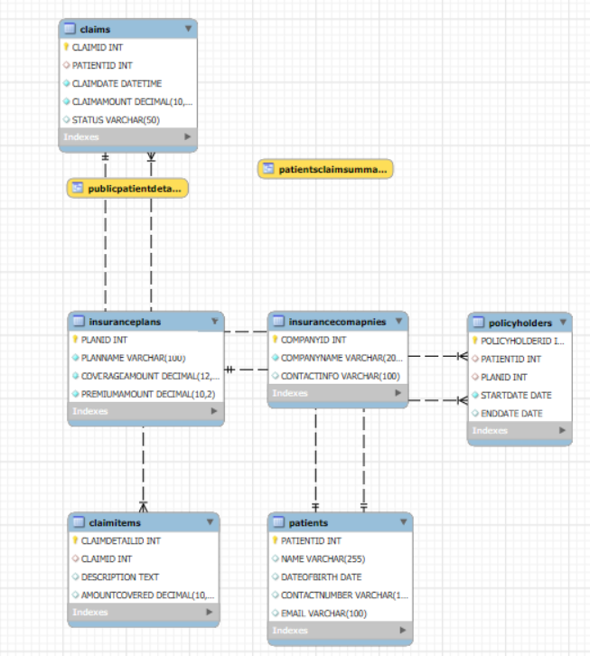
ER Diagram Design
Observations: This ER diagram illustrates a health-related database schema with entities for patients, insurance plans/companies, policies, claims, and claim details, linked by relationships.

Slide 7
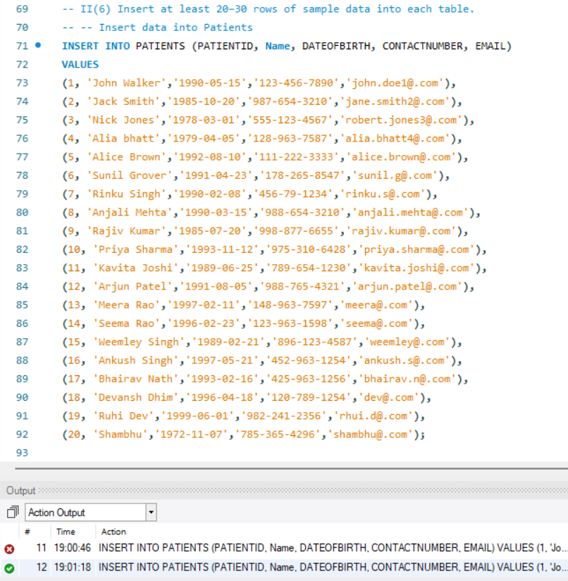
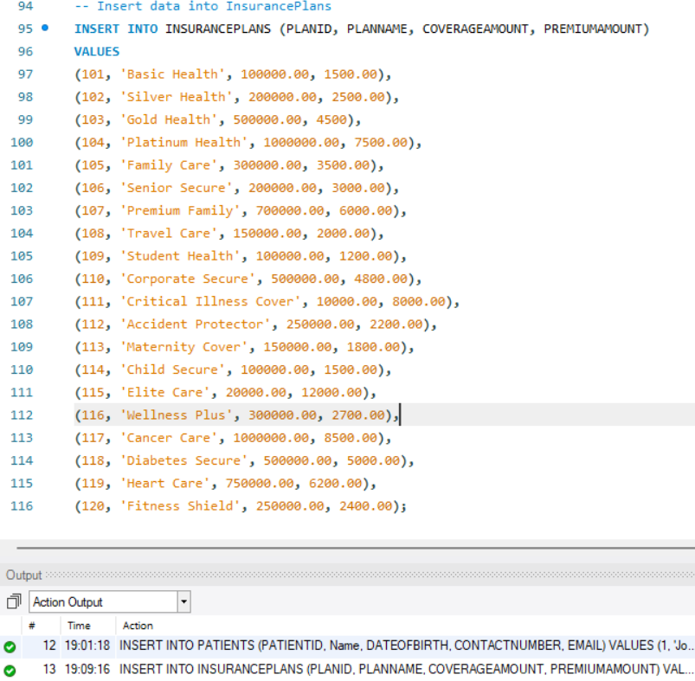
Data Insertion and Manipulation (DML)
Observations: The Table inserts initial data records into the PATIENTS table
Observations: The Table adds sample entries for various insurance plans into the INSURANCEPLANS table.

Slide 8
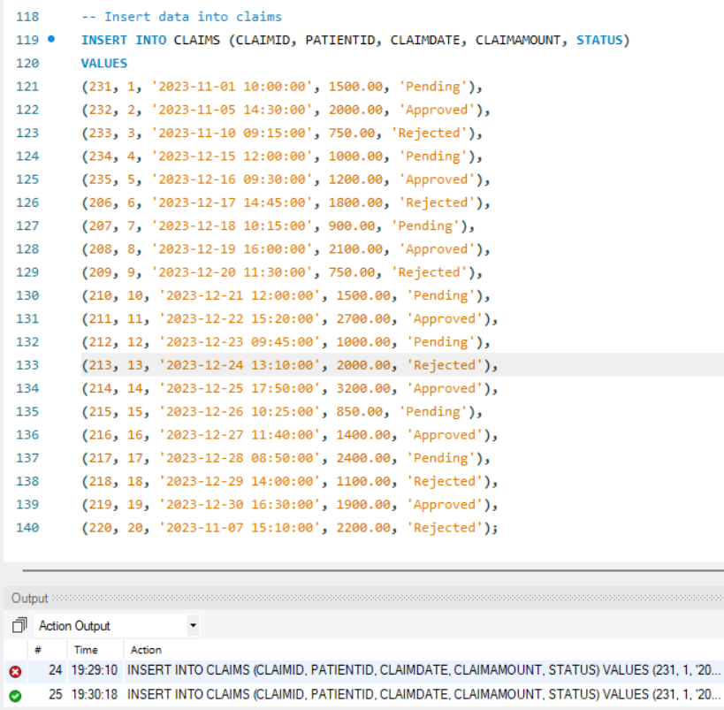
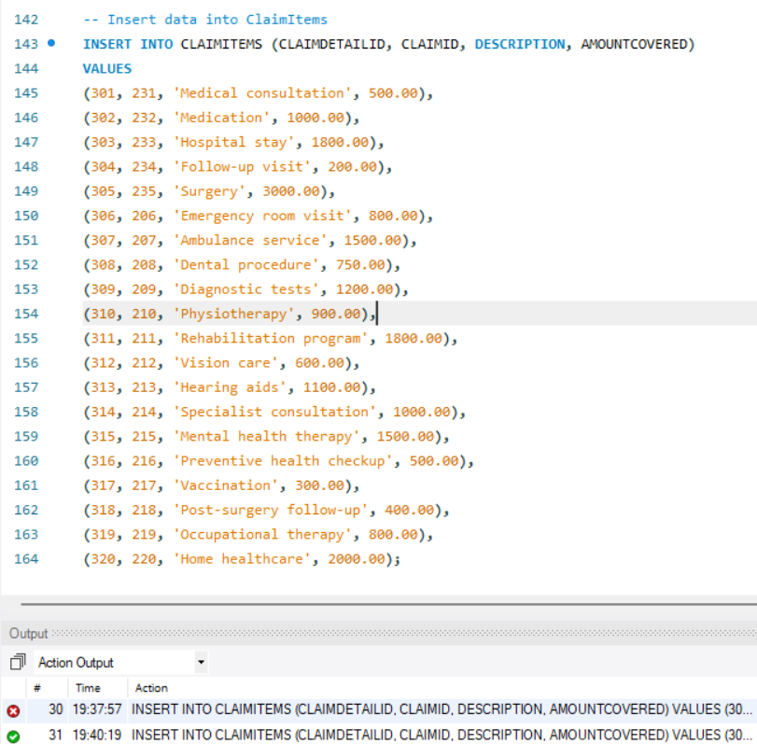
Data Insertion and Manipulation (DML)
Observations: The Table populates the CLAIMS table with initial claim records, including patient IDs, claim dates, amounts, and statuses.
Observations: This inserts specific details for individual claim items into the CLAIMITEMS table, referencing corresponding claim IDs and including descriptions and covered amounts

Slide 9
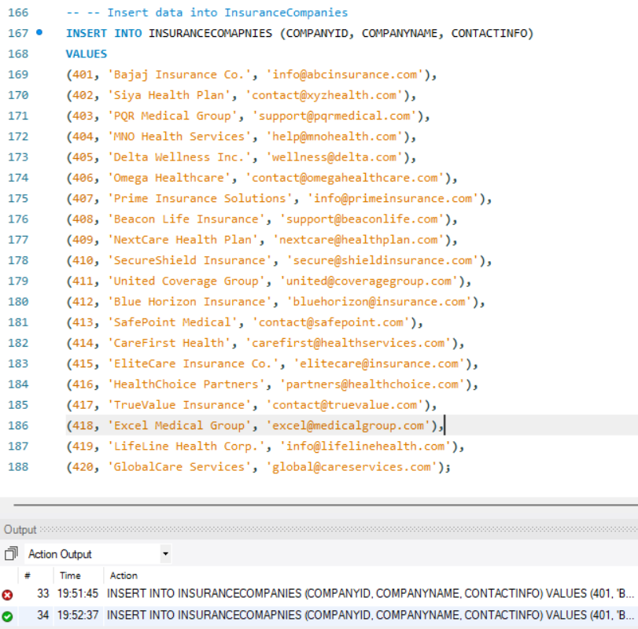
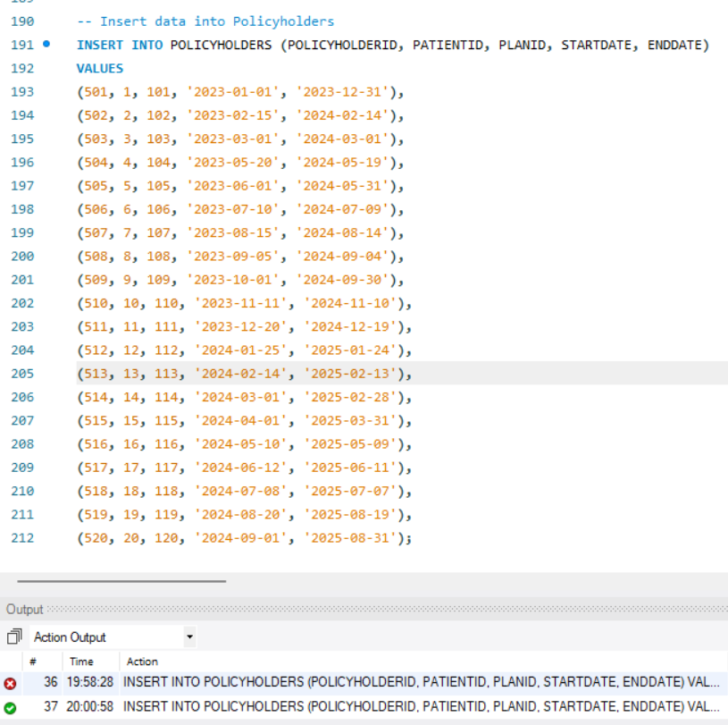
Data Insertion and Manipulation (DML)
Observations: Inserting records linking patients to their insurance plans with specific start and end dates into the POLICY HOLDERS table.
Observations: Inserting records for various insurance companies with their names and contact information into the INSURANCE COMPANIES table.

Slide 10
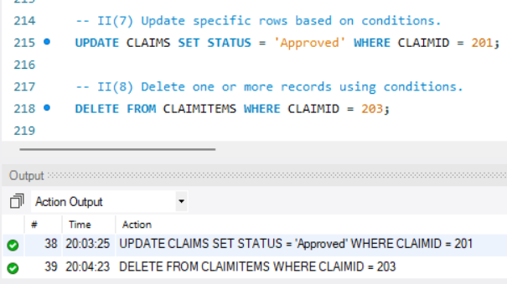
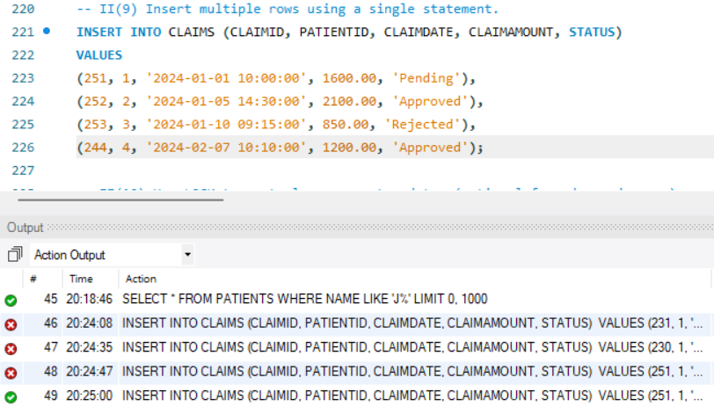
Data Insertion and Manipulation (DML)
Observations: Claim with ID 201 had its status updated to 'Approved', and claim items associated with claim ID 203 were deleted.
Observations: This inserts multiple new claim records into the CLAIMS table with specified details

Slide 11
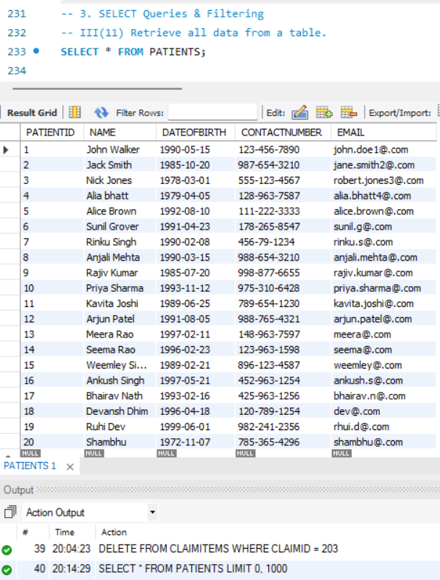
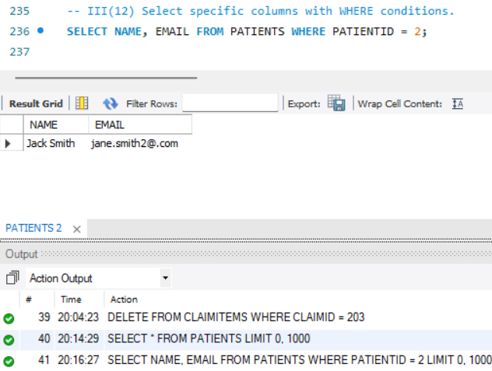
SELECT Queries & Filtering
Observations: The name and email of the patient with PATIENTID equal to 2 were selected and displayed
Observations: All data was retrieved and displayed from the PATIENTS table

Slide 12
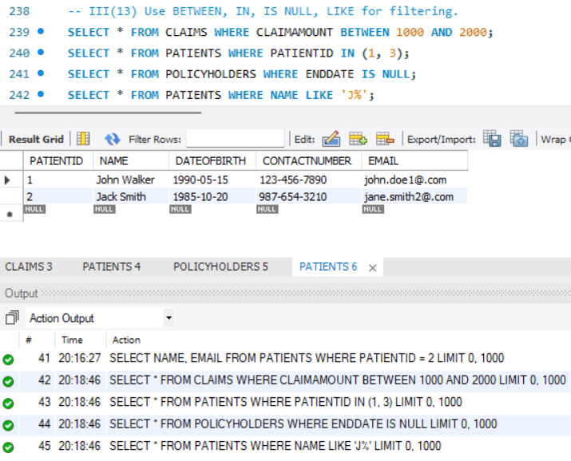
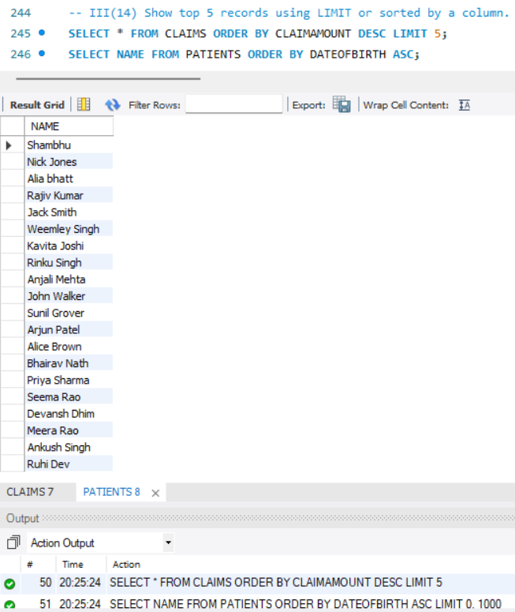
SELECT Queries & Filtering
Observations: Claims with amounts between 1000 and 2000, policyholders with no end date, and patients whose names start with 'J' were selected.
Observations: The top 5 claims with the highest claim amounts were selected, and patient names were listed, ordered by their date of birth in ascending order

Slide 13
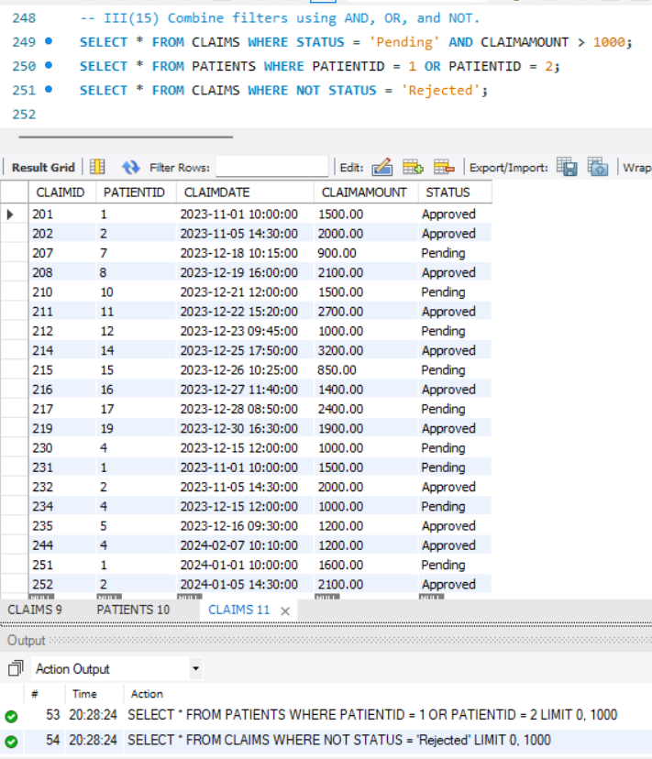
SELECT Queries & Filtering
Observations: Claims with a 'Pending' status and claim amount greater than 1000 were selected, along with patients having either PATIENTID 1 or 2, and claims that do not have a 'Rejected' status.

Slide 14
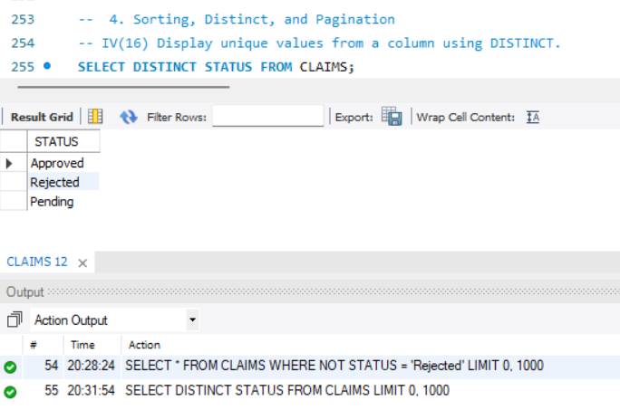
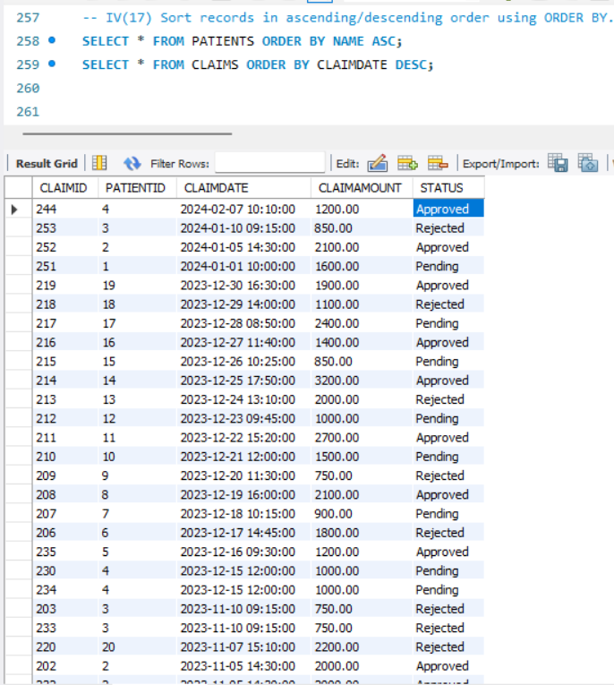
Sorting, Distinct, and Pagination
Observations: Patient records were displayed, sorted alphabetically by name, and claim records were shown, ordered by claim date in descending order.
Observations: The unique status values present in the CLAIMS table were retrieved and displayed

Slide 15
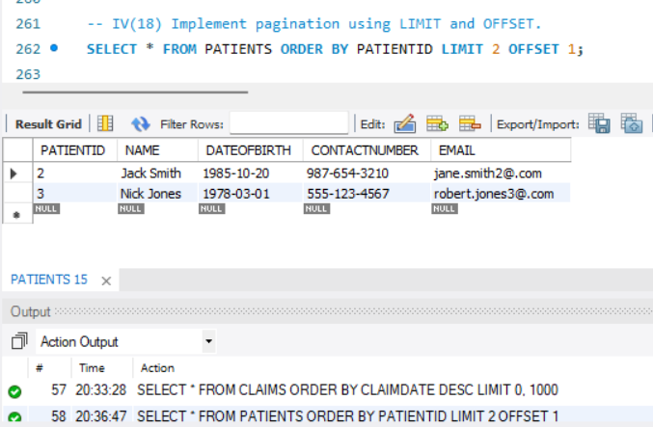
Sorting, Distinct, and Pagination
Observations : Patient records were retrieved, ordered by PATIENTID, skipping the first record and displaying the next two.

Slide 16
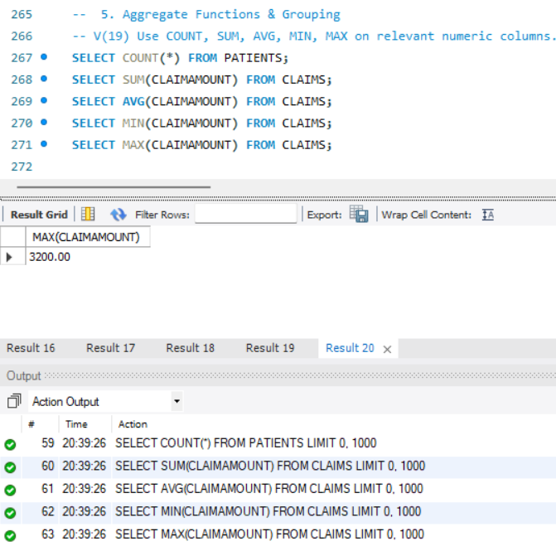
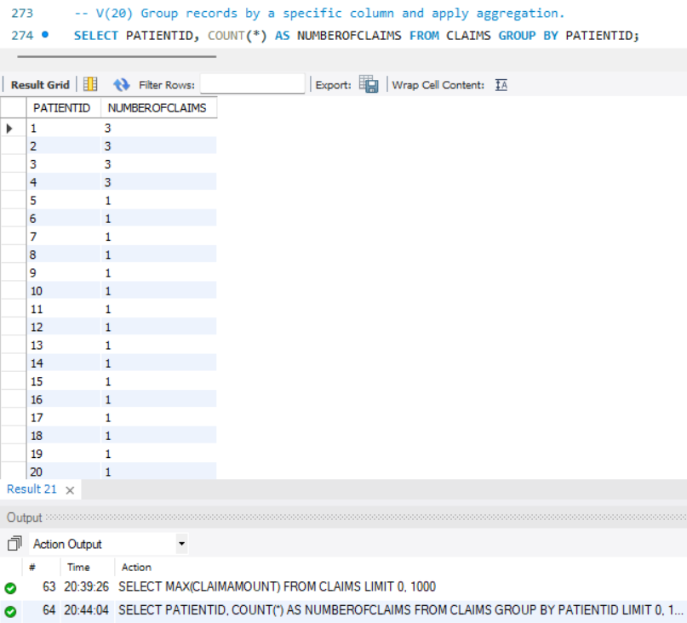
Aggregate Functions & Grouping
Observations: The total number of patients was counted, and the sum, average, minimum, and maximum claim amounts from the CLAIMS table were calculated.
Observations: The number of claims for each patient was counted and displayed, grouped by PATIENTID

Slide 17
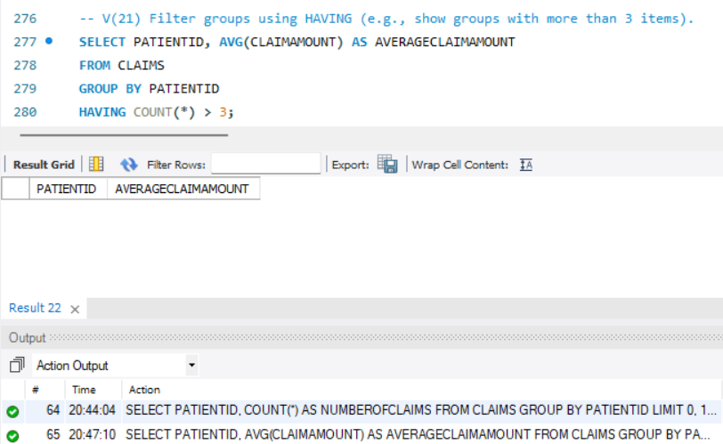
Aggregate Functions & Grouping
Observations: The average claim amount was calculated for each patient, but only those patients with more than three claims were included in the result.

Slide 18
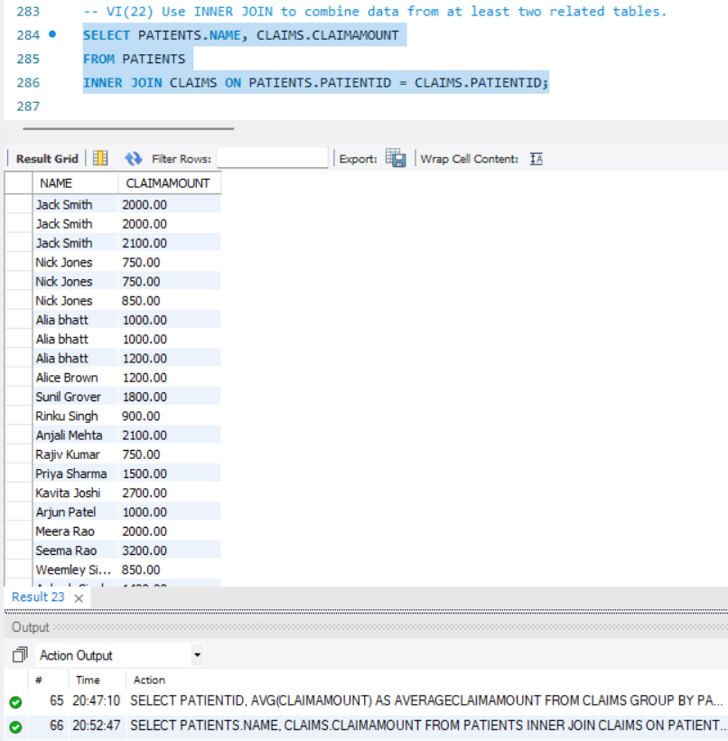
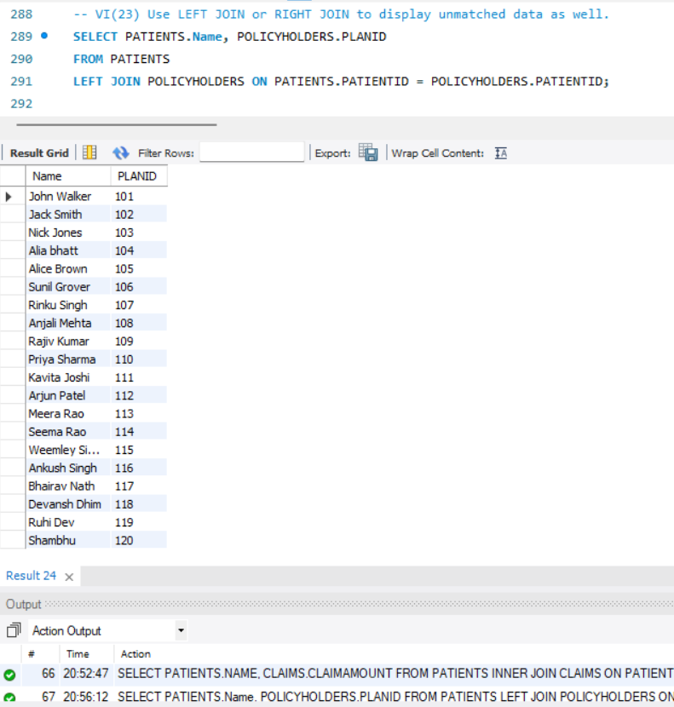
Joins
Observations: Patient names and their corresponding claim amounts were retrieved by joining the PATIENTS and CLAIMS tables based on matching PATIENTID.
Observations: Patient names and their associated policy plan IDs were retrieved using a left join between the PATIENTS and POLICYHOLDERS tables.

Slide 19
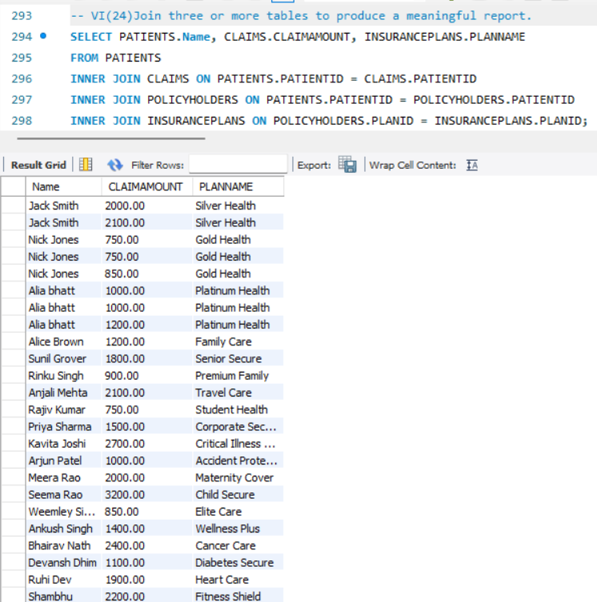
Joins
Observations: Patient names, their claim amounts, and the corresponding insurance plan names were retrieved by joining PATIENTS, CLAIMS, POLICYHOLDERS, and INSURANCEPLANS tables

Slide 20
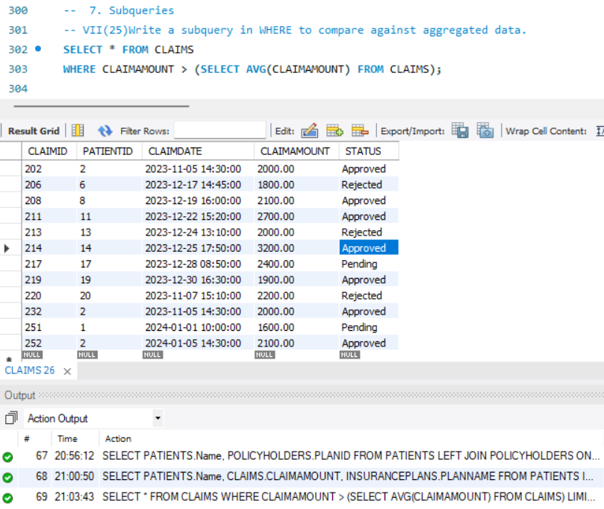
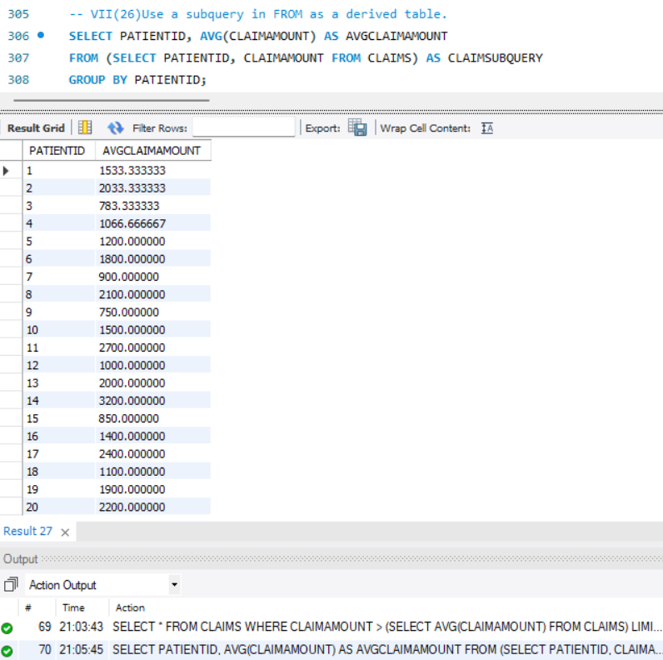
Subqueries
Observations: Claims with amounts greater than the average claim amount across all claims were selected.
Observations:The average claim amount for each patient was calculated using a subquery that selected patient IDs and claim amounts.

Slide 21
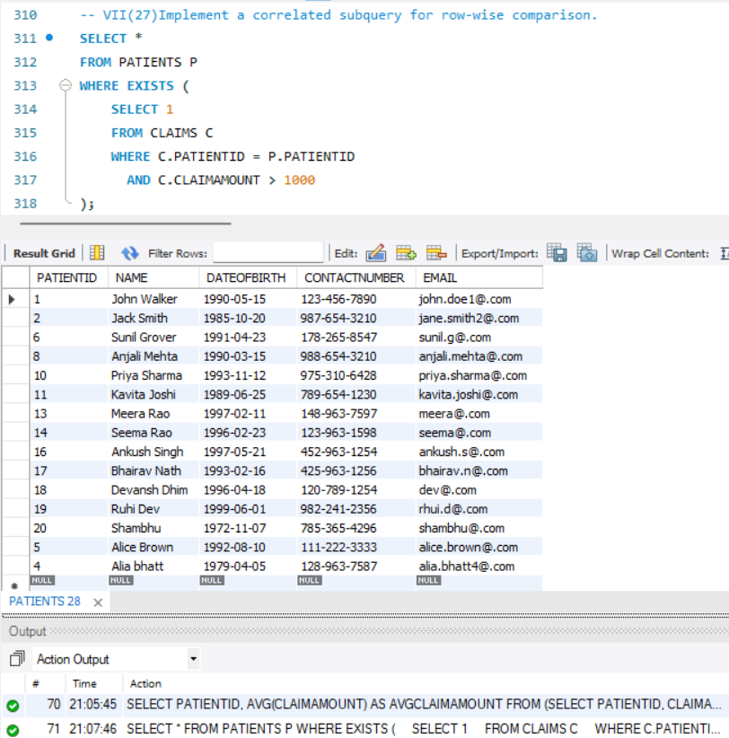
Subqueries
Observations: Patients who have at least one claim with an amount greater than 1000 were selected using a correlated subquery.

Slide 22
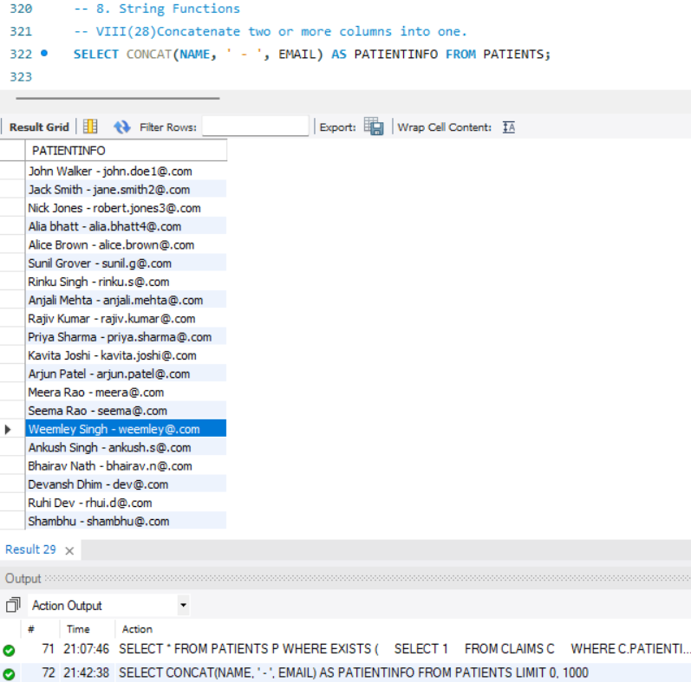
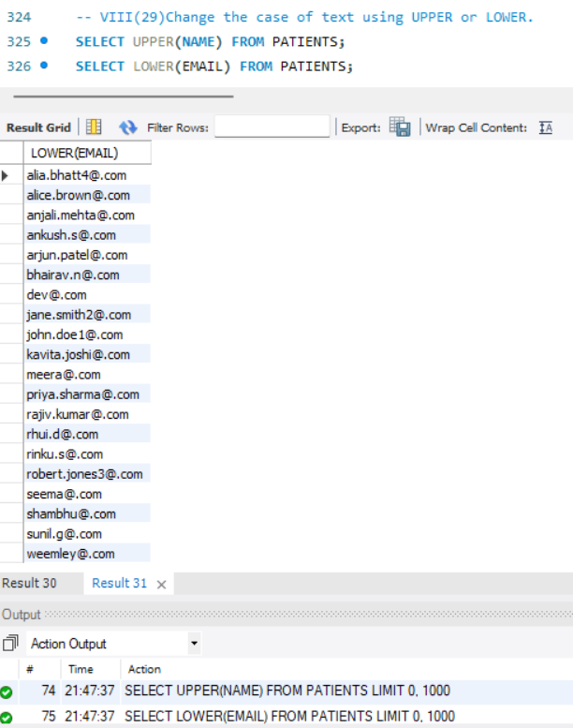
String Functions
Observations: Patient names and email addresses were combined into a single PATIENTINFO column.
Observations: Patient names were converted to uppercase, and patient email addresses were converted to lowercase.

Slide 23
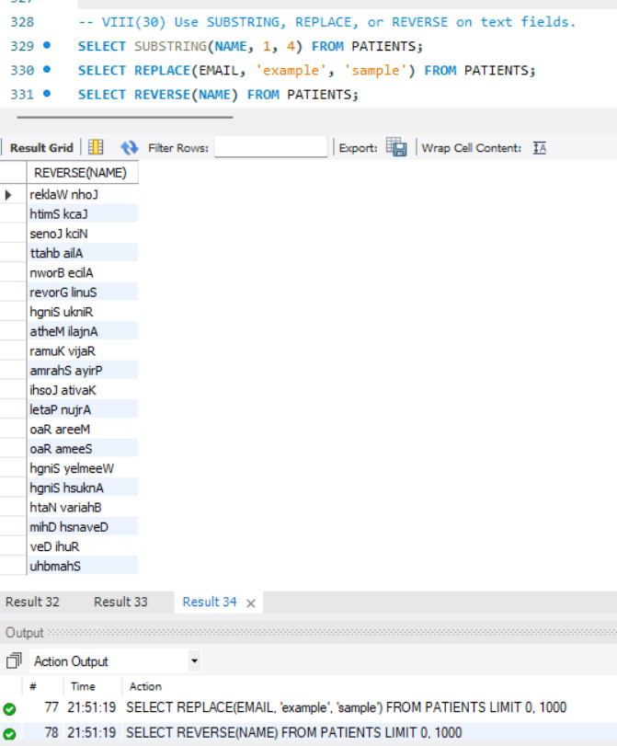
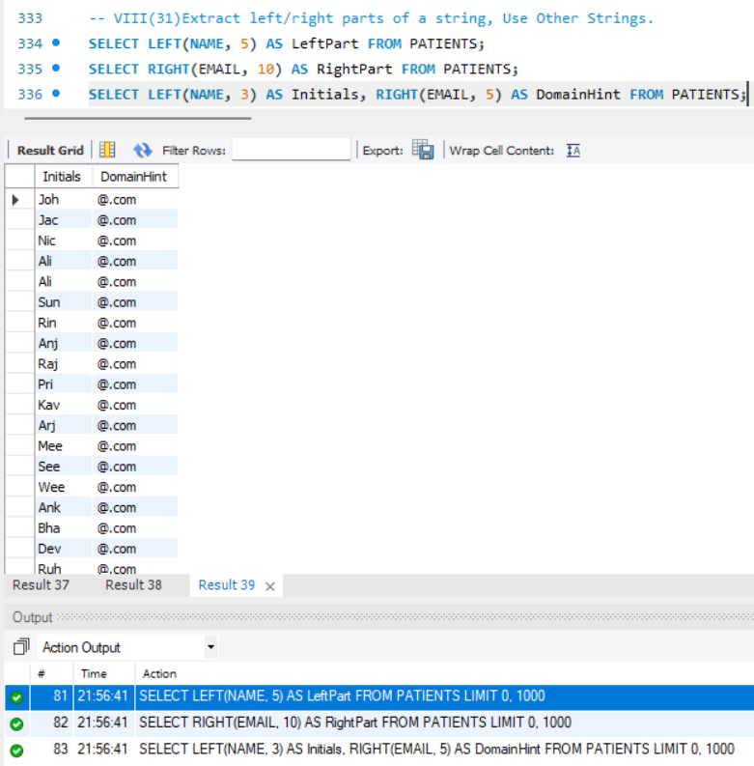
String Functions
Observations:The first four characters of each patient's name were extracted, email addresses had 'example' replaced with 'sample', and patient names were displayed in reverse
Observations: The first five characters of each patient's name were extracted as Left Part, the last ten characters of their email as Right Part, and the first three characters of the name combined with the last five of the email as Initials and Domain Hint respectively.

Slide 24
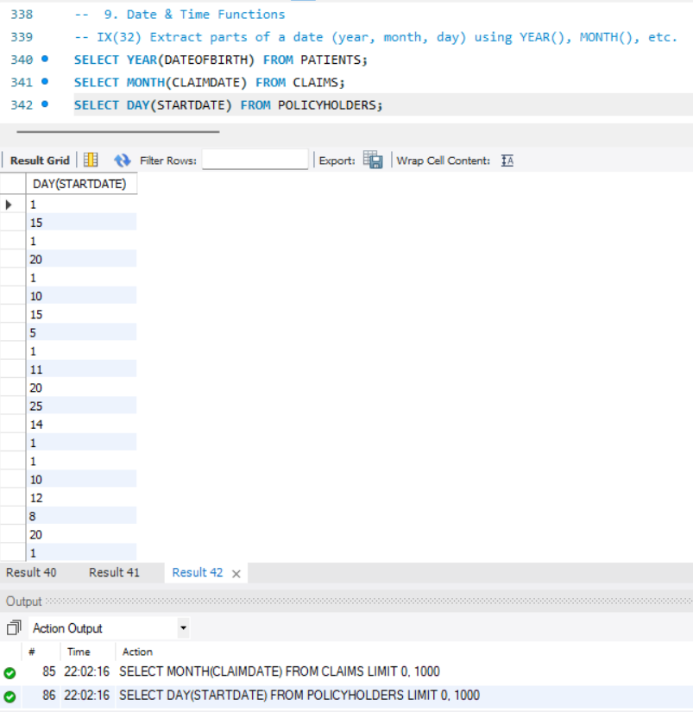
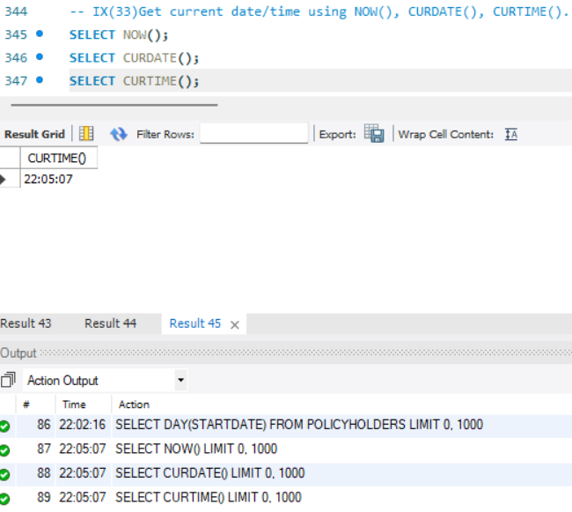
Date & Time Functions
Observations: The current date and time, current date, and current time were retrieved
Observations: Years from patient birth dates, months from claim dates, and days from policy start dates were extracted.

Slide 25
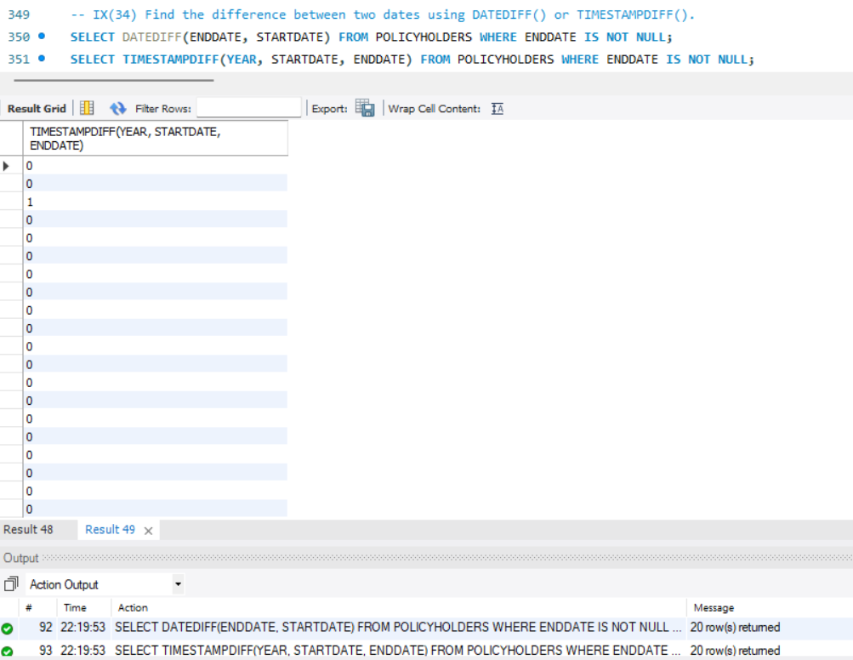
Date & Time Functions
Observations: The difference in days between the end and start dates, and the difference in years between the end and start timestamps were calculated for policies with a defined end date.

Slide 26
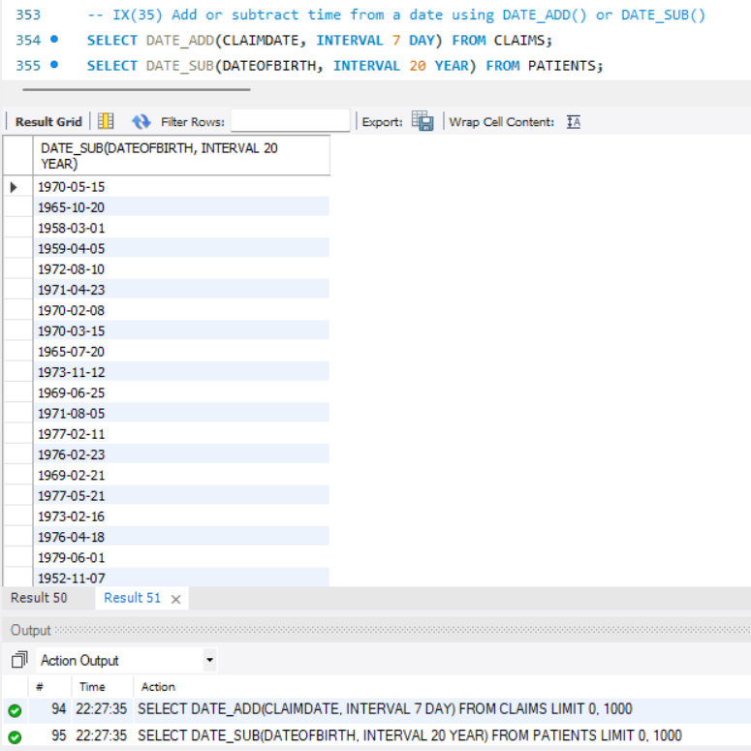
Date & Time Functions
Observations: Seven days were added to each claim date, and twenty years were subtracted from each patient's birth date.

Slide 27
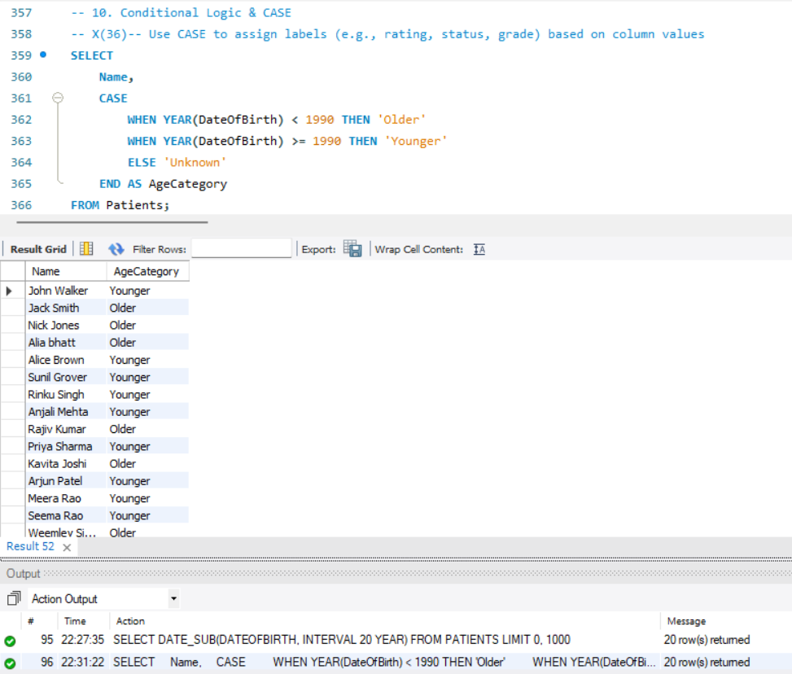
Conditional Logic & CASE
Observations: Patients were categorized as 'Older' if born before 1990 and 'Younger' if born in or after 1990

Slide 28
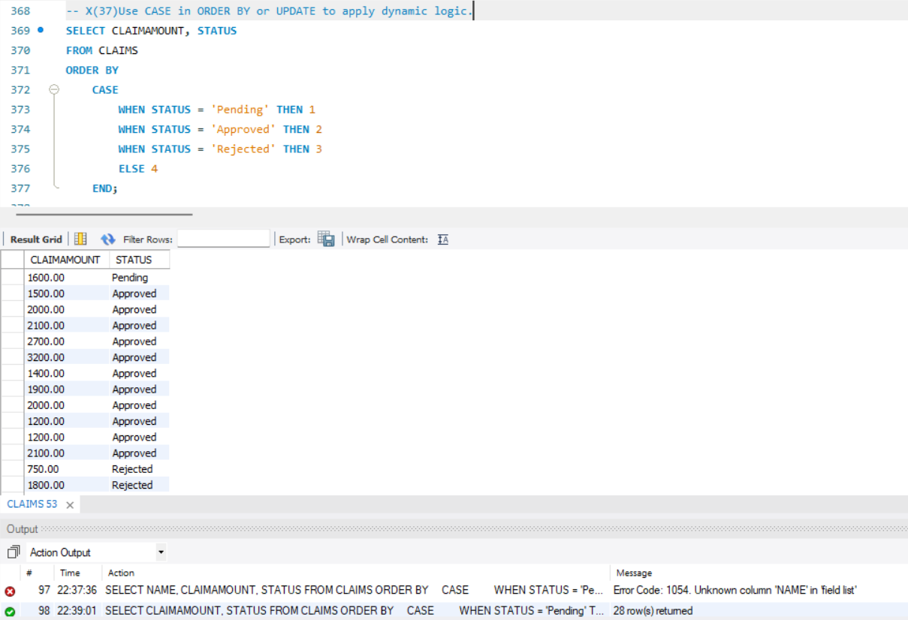
Conditional Logic & CASE
Observations: Claims were ordered based on their status, assigning numerical values to 'Pending', 'Approved', and 'Rejected' statuses.

Slide 29
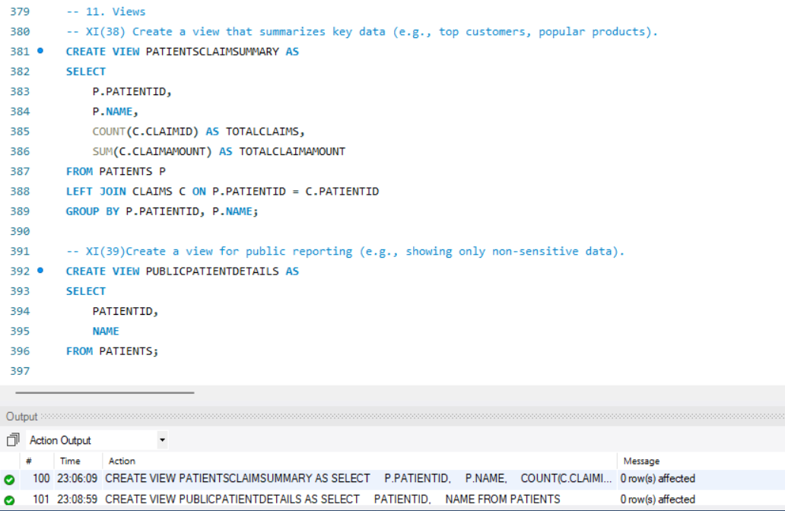
Views
Observations: A view Patients Claim Summary was created to show each patient's total number and amount of claims, and another view Public Patient Details was created with patient IDs and names.

Slide 30
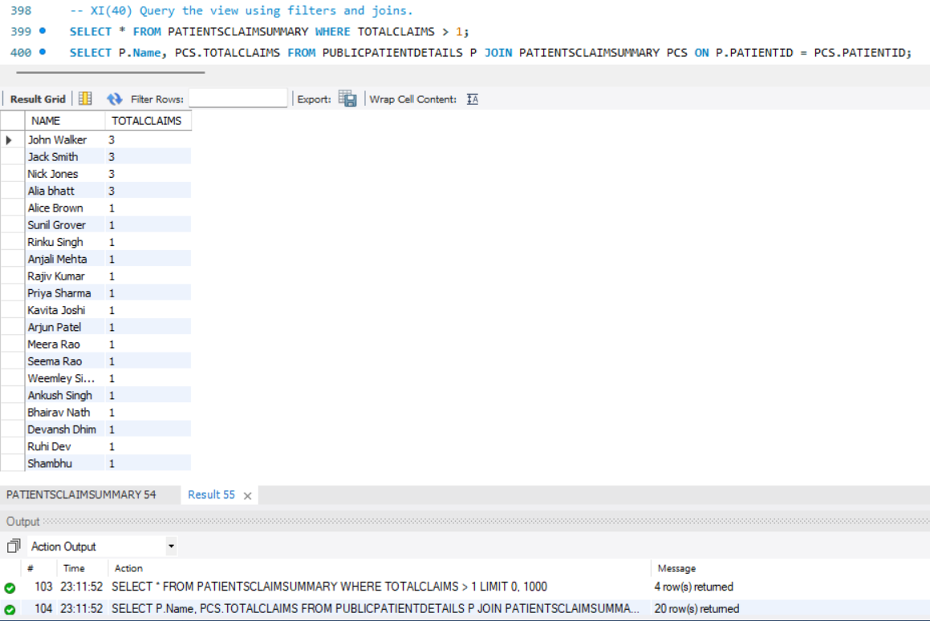
Views
Observations: A view Patients Claim Summary was created to show each patient's total number and amount of claims, and another view Public Patient Details was created with patient IDs and names.

Slide 31

THANK YOU

